Slide 1

Conclusion
Text Similarity: Cosine Similarity
Text Paraphrase: Pegasus Model
Text Summarize: Automatic Text Summarization

Slide 2

Accuracies
Grammatically
Semantically

Slide 3
Future
Various Deep Learning Models
Parrot Model (Text Paraphrasing)
Gensim Model (Text Summarization)

Slide 4
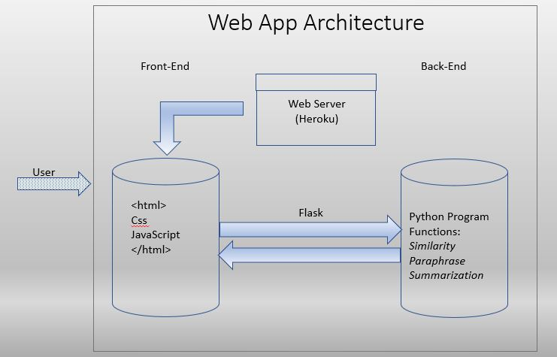
Challenges

Slide 5
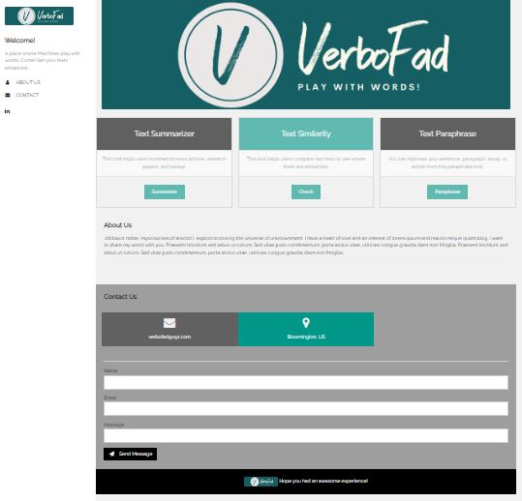

Slide 6
Thank You!!

